Slide 1


micro:bit entry video tutorial
Lesson 19
micro:bit creative lesson 19 “Automatic door”
YahBoom micro:bit creative tutorial

Slide 2
micro:bit entry video tutorial
Content
Part1
Part 2
Part3
Part 4
Part 5
Learning goals
Preparation
Handmade
Search for blocks
Combine blocks
YahBoom micro:bit creative tutorial

Slide 3
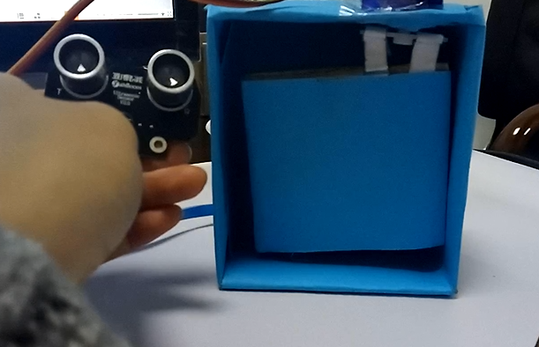
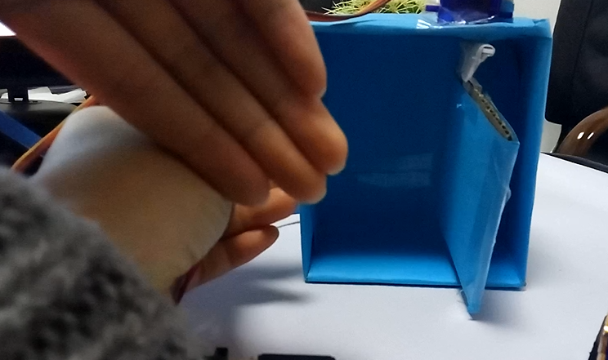
micro:bit entry video tutorial
Part 1
Learning
goals
After you download the program,please the ultrasonic module on the side of the door. If the ultrasonic module is blocked by hand (simulating someone standing in front of the door), the servo will rotate 90 degrees to open the door. After two seconds, the door will automatically close. Let's try it together.
YahBoom micro:bit creative tutorial

Slide 4
micro:bit entry video tutorial
Part 2
Hardware:
● 1 x Micro:bit Board
● 1 x Micro:bit expansion board
● 1 x servo kit
● 1 x Ultrasonic
● 1 x door ( Owned )
● 4 x DuPont line female to male
● 3 x DuPont line male to male
● 1 x Power module
● 1 x Breadboard
● 1 x PC
● 1 x USB Cable
Preparation
Then the micro:bit is connected to the computer through USB,
and the computer will pop up a U disk and click the URL in the U disk
to enter the programming interface.Input this URL
https://github.com/lzty634158/yahboom_mbit_en to get the package.
YahBoom micro:bit creative tutorial

Slide 5
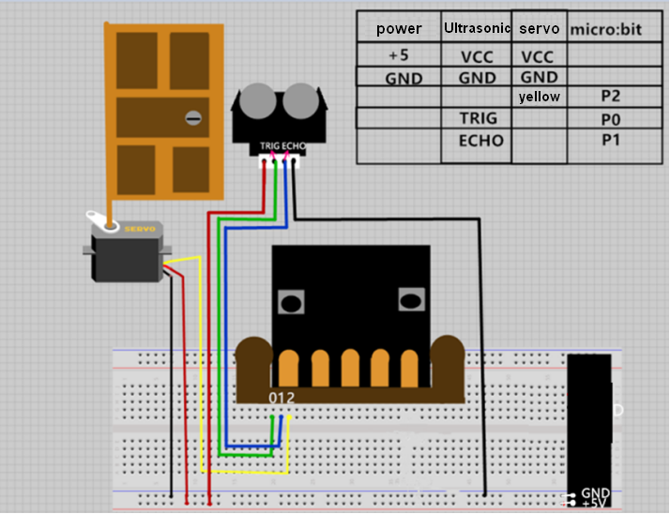
micro:bit entry video tutorial
Part 3
handmade
YahBoom micro:bit creative tutorial

Slide 6
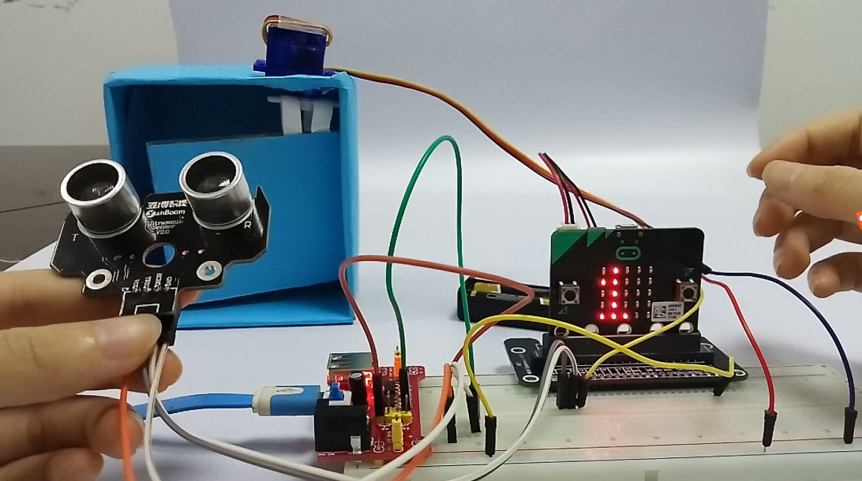
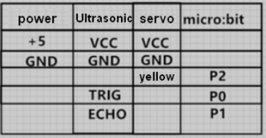
micro:bit entry video tutorial
Part 3
handmade
In this lesson we will use the servos and ultrasonic module. Both VCCs must be connected to 5V.
How to distinguish the positive and negative of the servo?
The brown line of servo is the negative pole, the red line of servo is the positive pole, and the yellow line of servo is connected to P2. Ultrasonic TRIG is connected to P0, ECHO is connected to P1, and everyone can use the charging treasure to supply power to the 5v power supply module. The servo, ultrasonic and micro:bit negative (GND) must be connected to the GND of the power supply.
YahBoom micro:bit creative tutorial

Slide 7
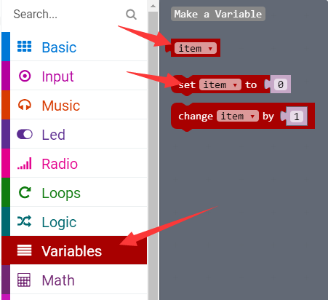
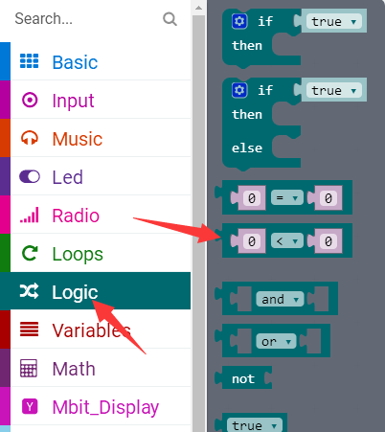
micro:bit entry video tutorial
Part 4
Search for
blocks
YahBoom micro:bit creative tutorial

Slide 8
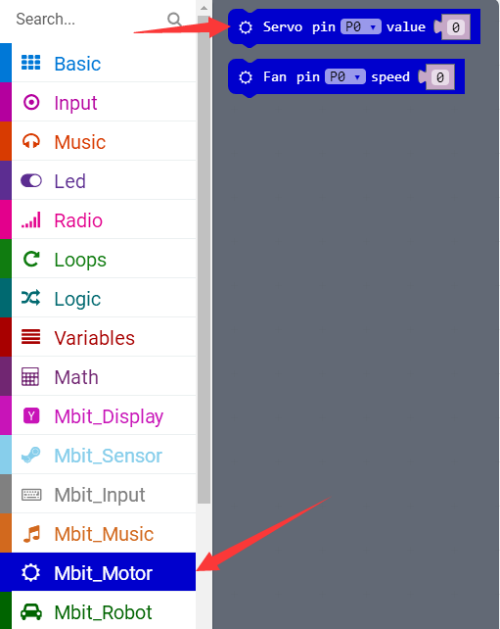
micro:bit entry video tutorial
Part 4
Search for
blocks
YahBoom micro:bit creative tutorial

Slide 9
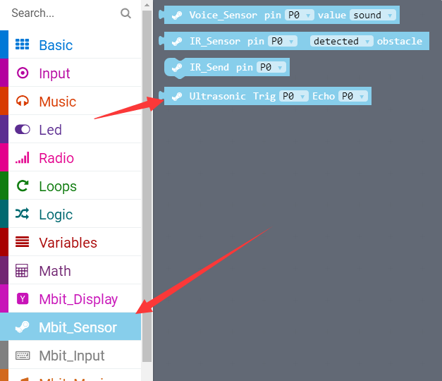
micro:bit entry video tutorial
Part 4
Search for
blocks
YahBoom micro:bit creative tutorial

Slide 10
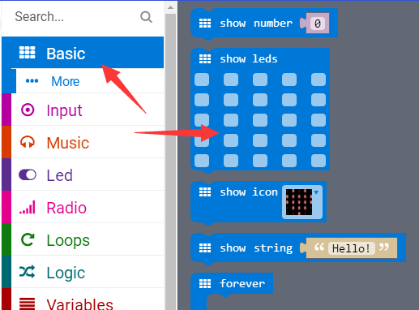
micro:bit entry video tutorial
Part 4
Search for
blocks
YahBoom micro:bit creative tutorial

Slide 11
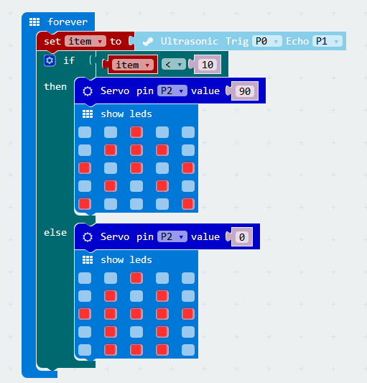
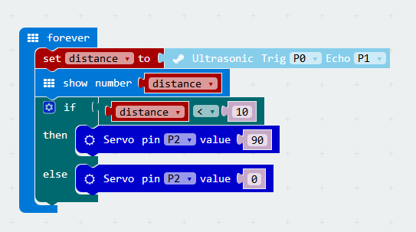
micro:bit entry video tutorial
Part 5
①
②
Combine
blocks
Dot matrix display distance version Dot matrix display image version
YahBoom micro:bit creative tutorial

Slide 12
micro:bit entry video tutorial
micro:bit
project
Thanks for watching!
Powered by
YahBoom
YahBoom micro:bit creative tutorial

